Slide 1
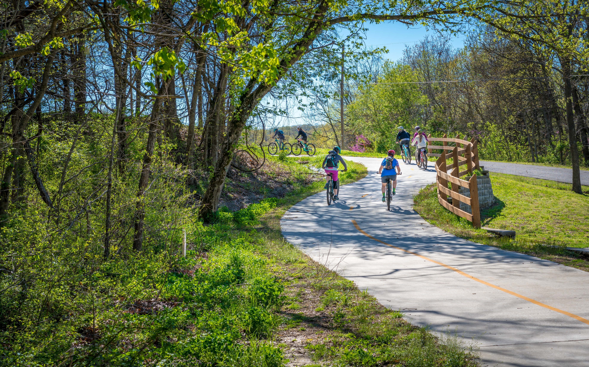


River Region Bike Walk Update
Final Report
January 20 & 22, 2026
Notes:
Change subtitle for each meeting

Slide 2
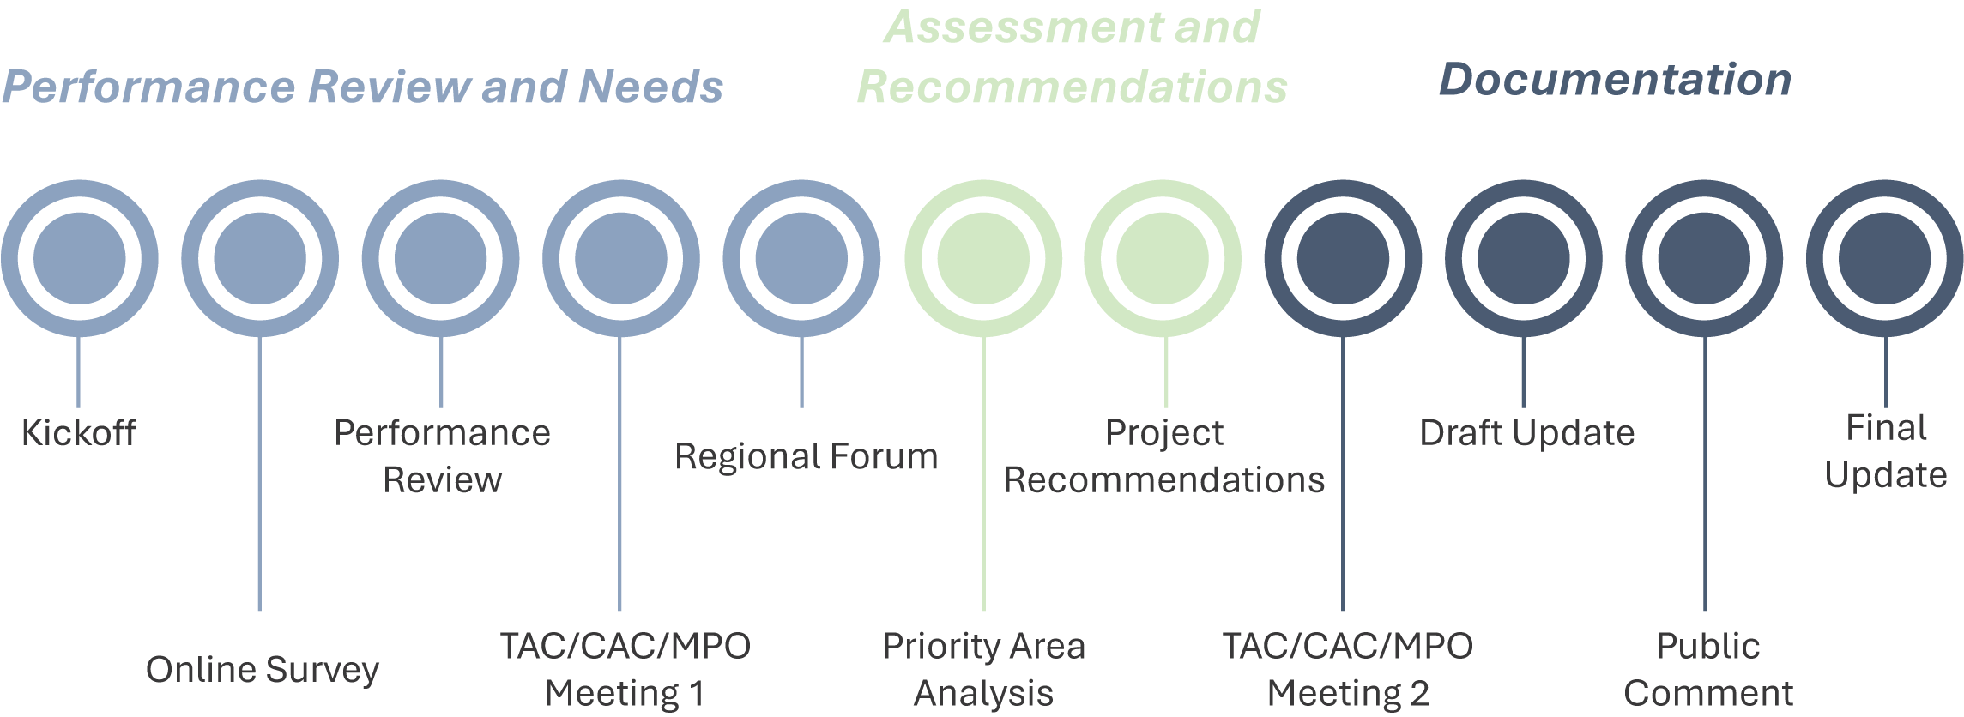
Project Schedule
Public Meeting

Slide 3
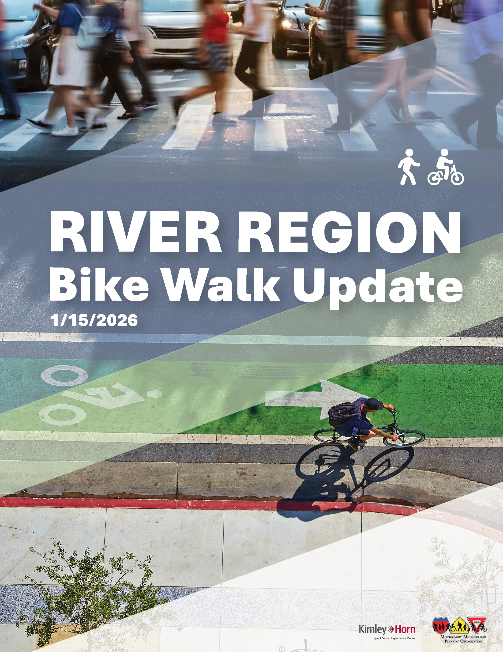
Report Contents
Executive Summary 01 Introduction 02 Existing Conditions 03 Public Outreach 04 Methods 05 Project Prioritization & Recommendations 06 Funding Strategies 07 Plan Implementation 08 Conclusion
Appendix A Project Priority List B Project Recommendation Maps C Public Survey Results D Design Guidelines

Slide 4
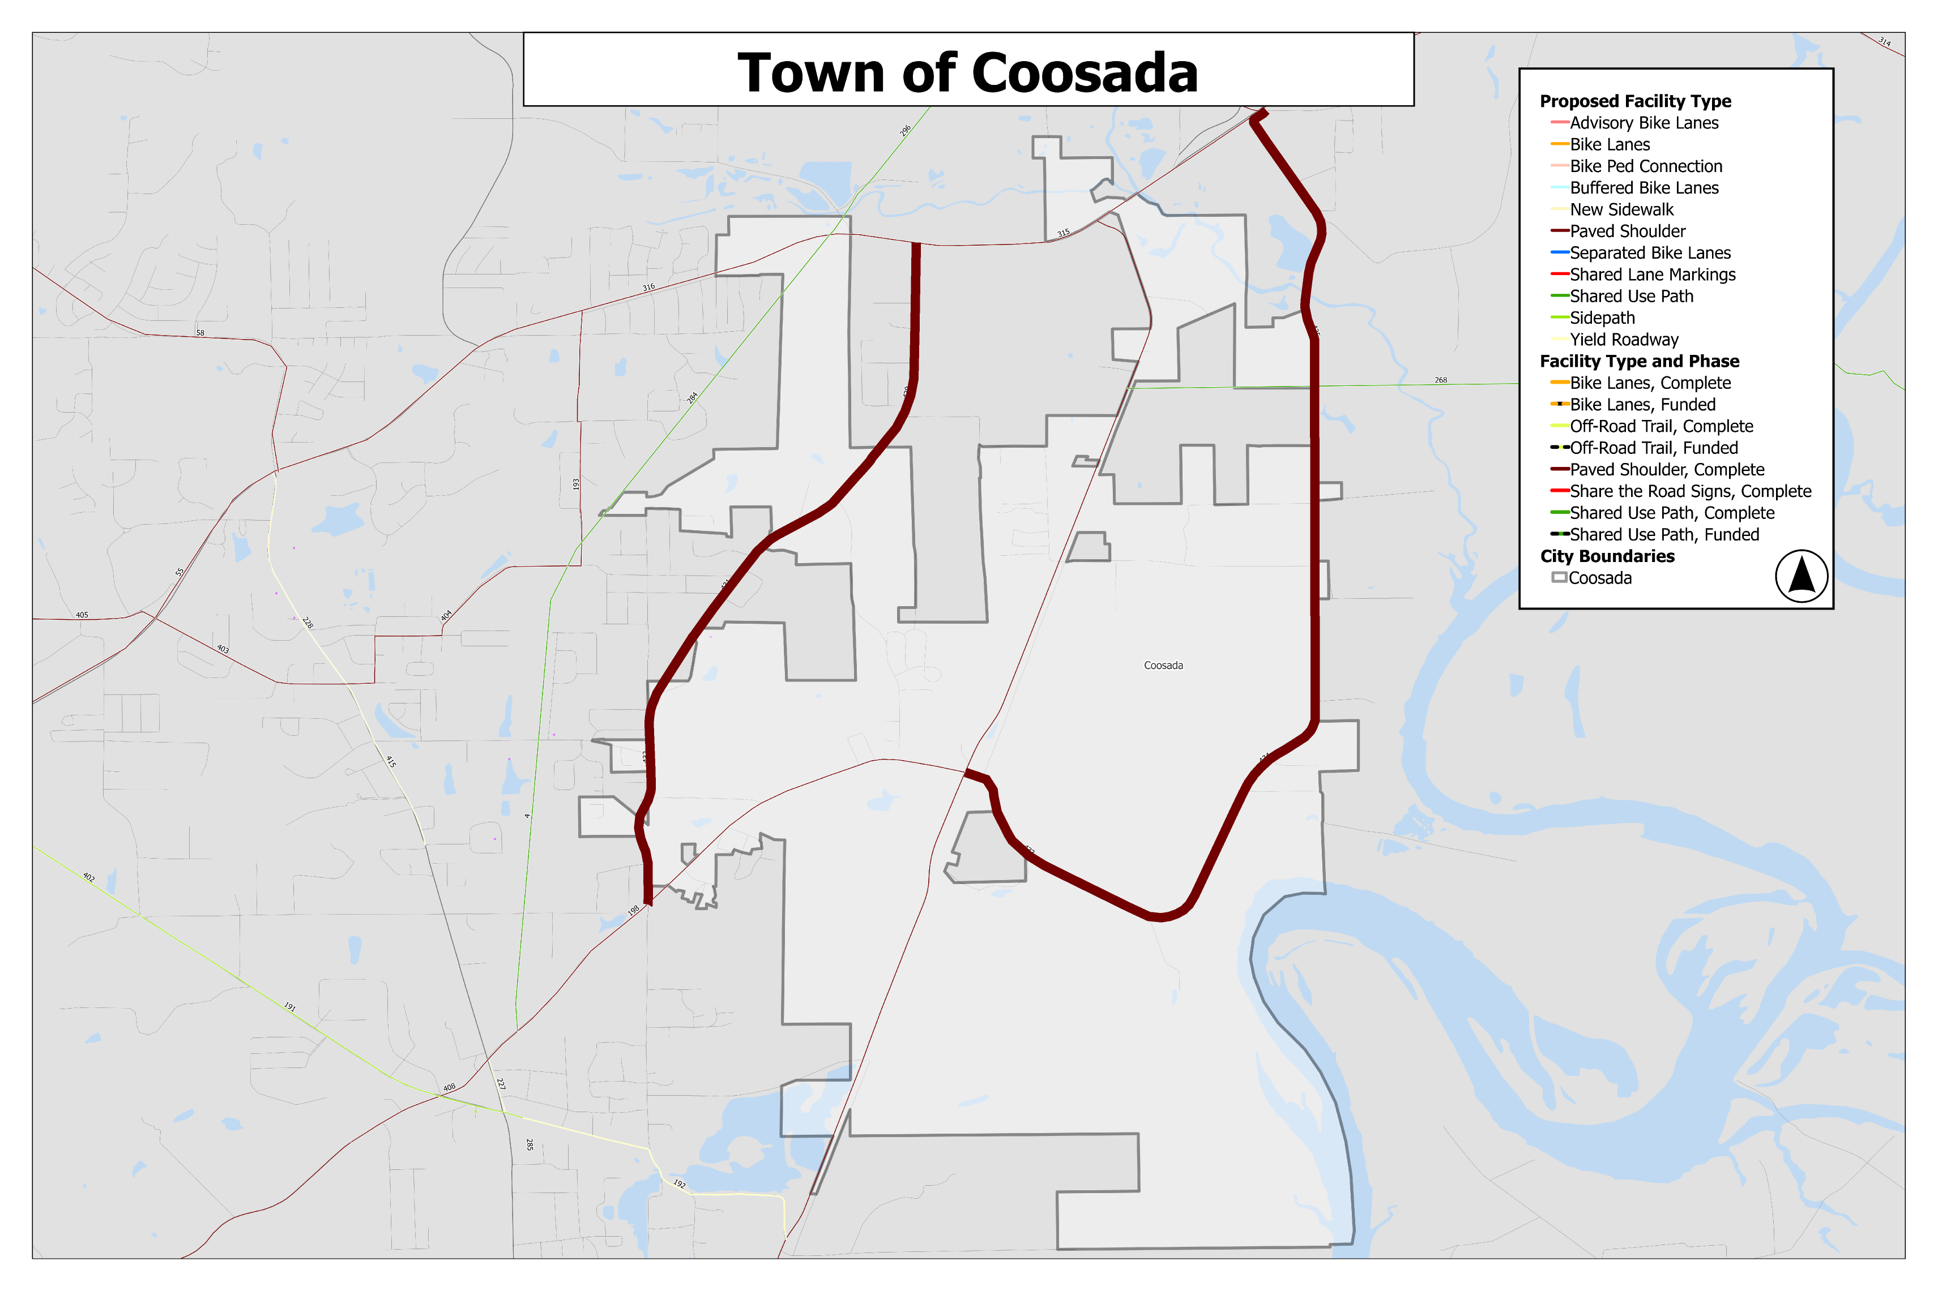
Public Comment Period Feedback
Two projects were added via public comment:
Town of Coosada
Airport Road
3.2 miles of paved shoulder from Coosada Rd. to AL State Route 14
Coosada Road/Rucker Road
4.9 miles of paved shoulder from Coosada Rd. @ Coosada Pkwy. to Rucker Road @ Lucky Town Road
Airport Road
Coosada Rd./Rucker Rd.

Slide 5
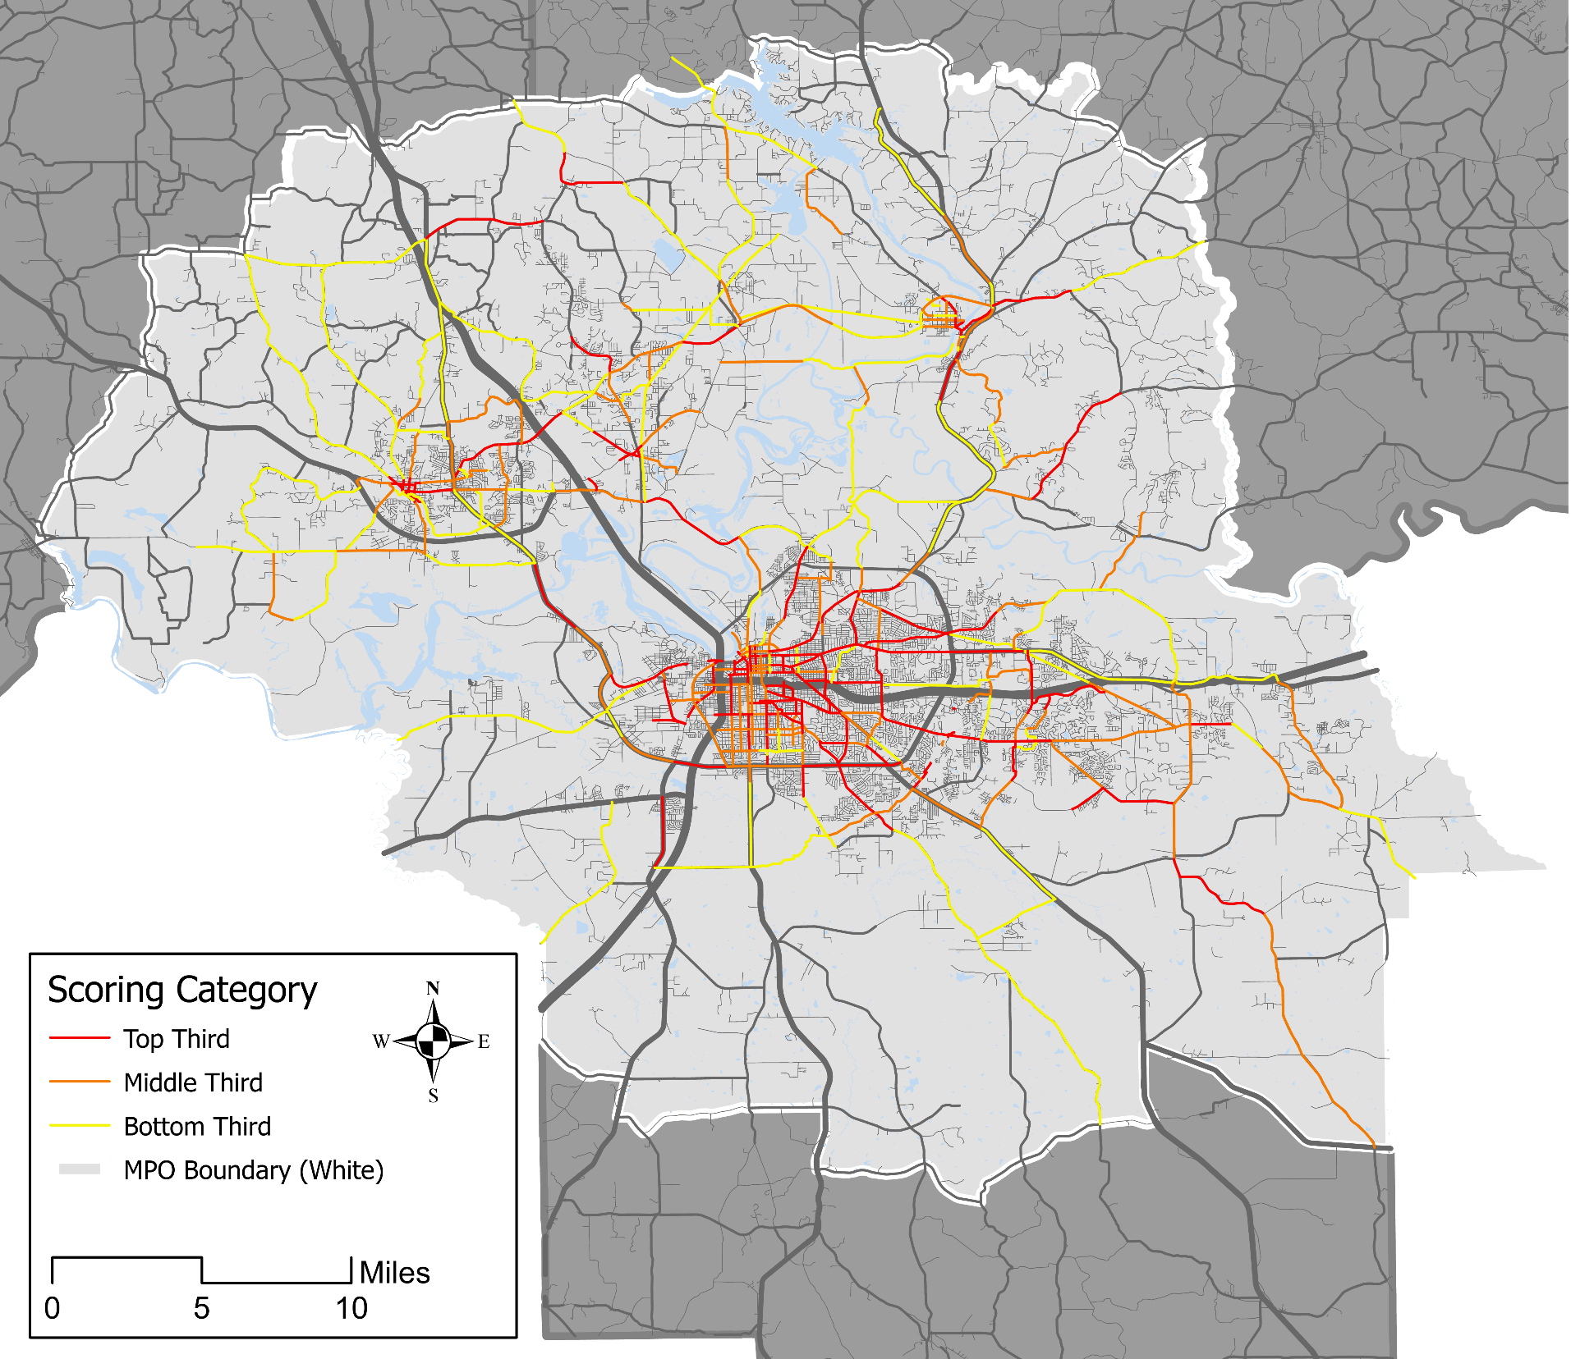
Final Recommendations
423 Total Projects
373 bicycle facilities
229 pedestrian facilities
Some facilities benefit cyclists and pedestrians:
Paved shoulders
Advisory bike lanes
Shared use paths
Sidepaths

Slide 6
Next Steps
Adopt and apply local policies (Complete Streets, traffic calming, SRTS) and conduct local outreach
Plan, design, and implement bike and pedestrian projects
Integrate biking and walking facilities into roadway development and repair plans
Adopt Plan
Begin Implementation
Maintain a regional bike and pedestrian infrastructure inventory
Pursue grant applications at the state, regional, and federal levels
Partner on development with local governments, developers, and non-profit organizations

Slide 7
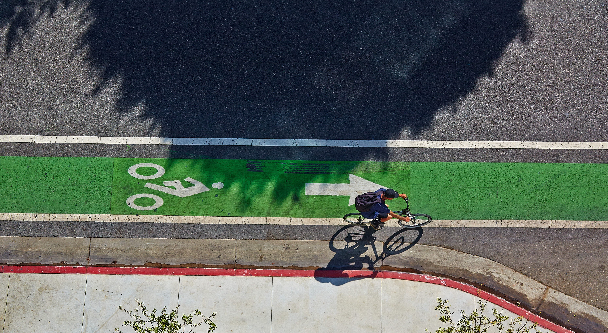
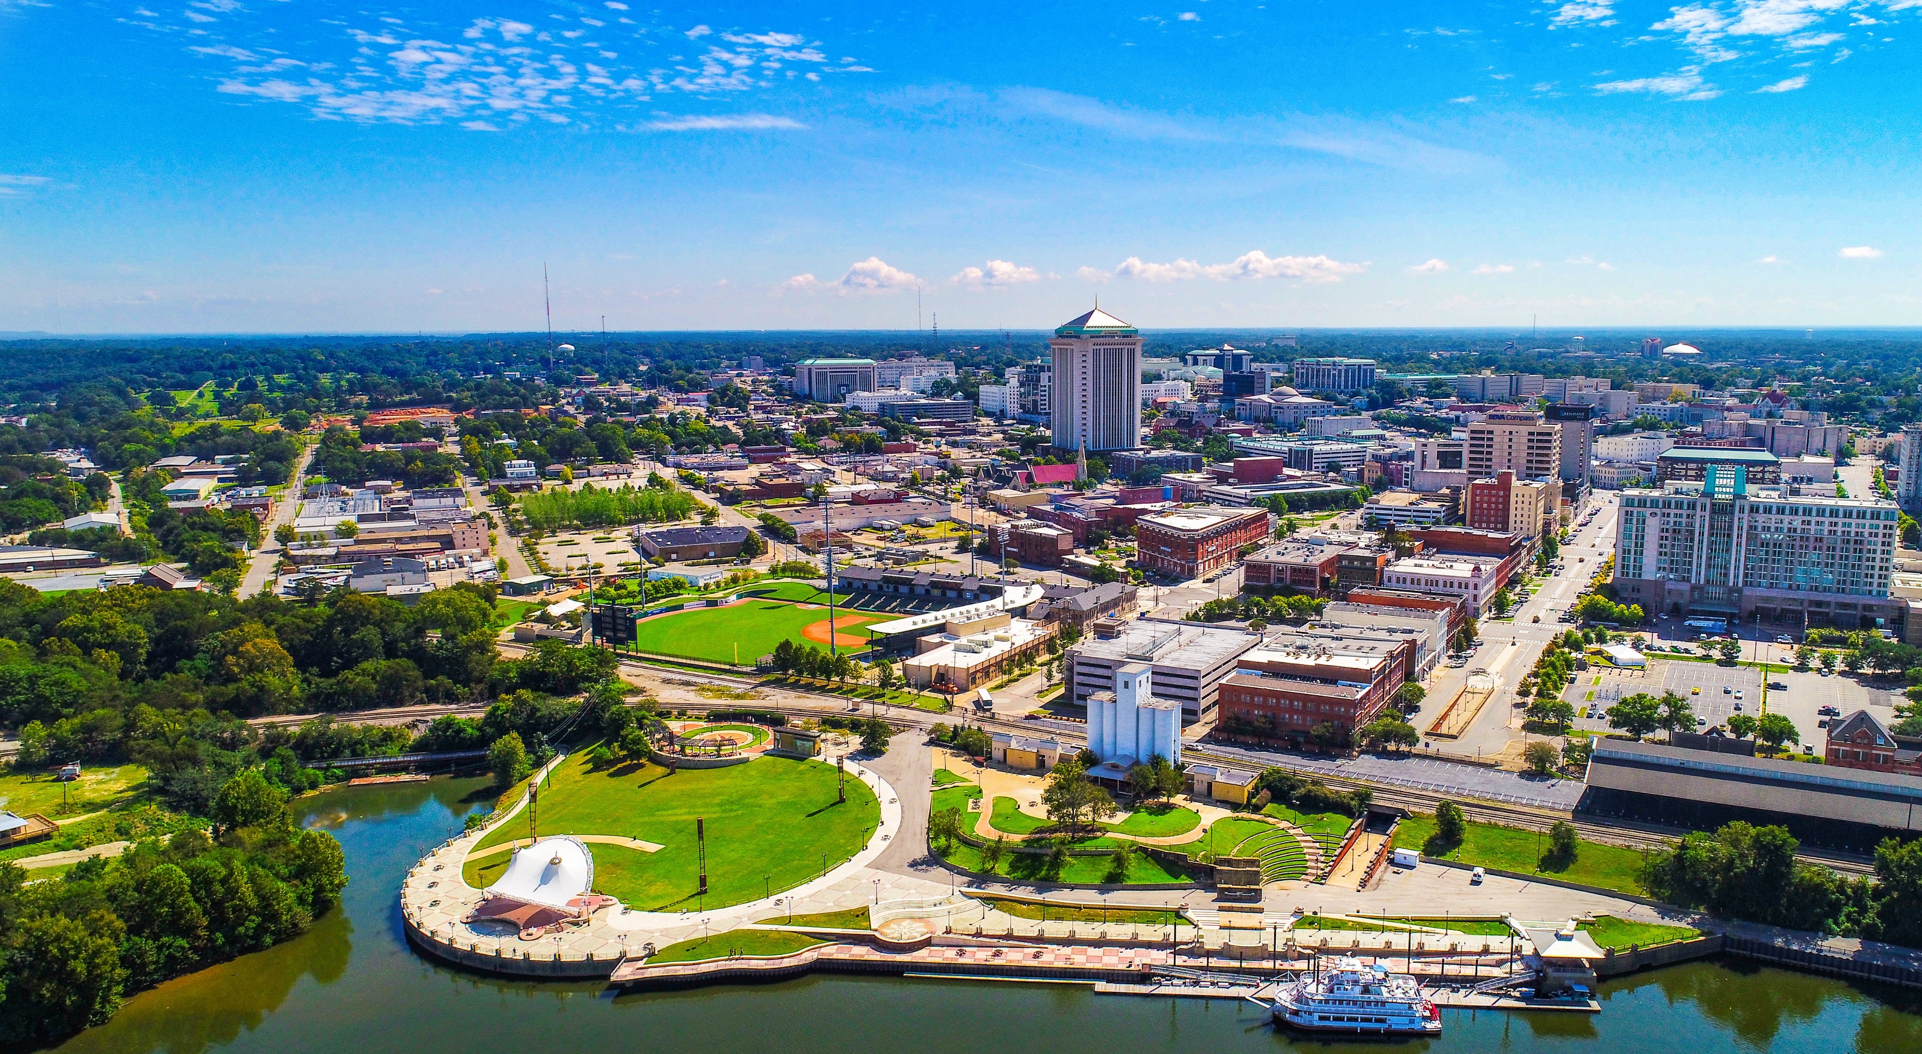
Discussion

